Slide 1
Open Data Versus Patron Privacy: A Fine Balance Ontario Library Association January 30, 2019 Presented by Sujoy Chatterjee Data Governance and Privacy Risk Advisor Toronto Public Library

Slide 2
Background on Open Data
Definition
“ Open Data is data that can be freely used, reused and redistributed by anyone, subject only, at most, to the requirement to attribute and share-alike” – The Open Data Handbook

Slide 3
TPL Approach to Open Data
Trust and Accountability
Transparency
Availability

Slide 4
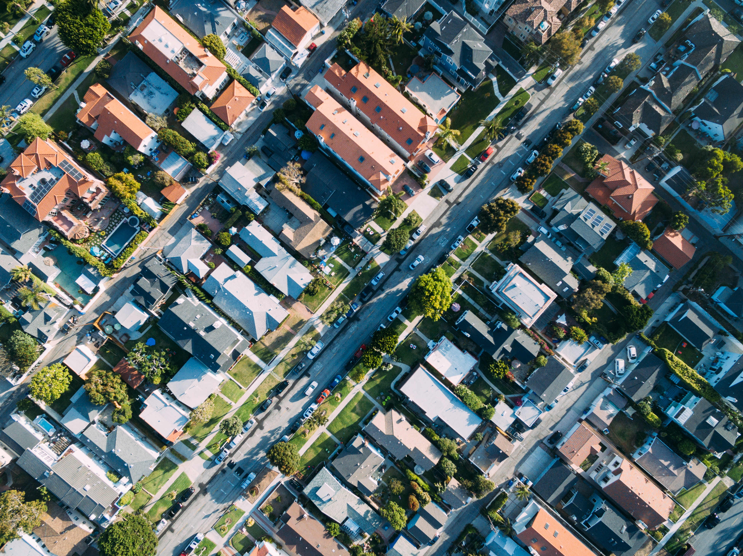
Open Data Portal
https://opendata.tpl.ca
Ability to layer TPL Data sets with City of Toronto Data providing insights on library use
Real-time data sets of what TPL users are searching for
http://dashboard.tpllabs.ca/index.html
TPL Subject Map: http://rhydomako.ca/tpl-catalogue-map/

Slide 5
Privacy and Open Data
De-identified or anonymized data
Data minimization: limiting what is collected in the first place
Data that is relevant and necessary

Slide 6
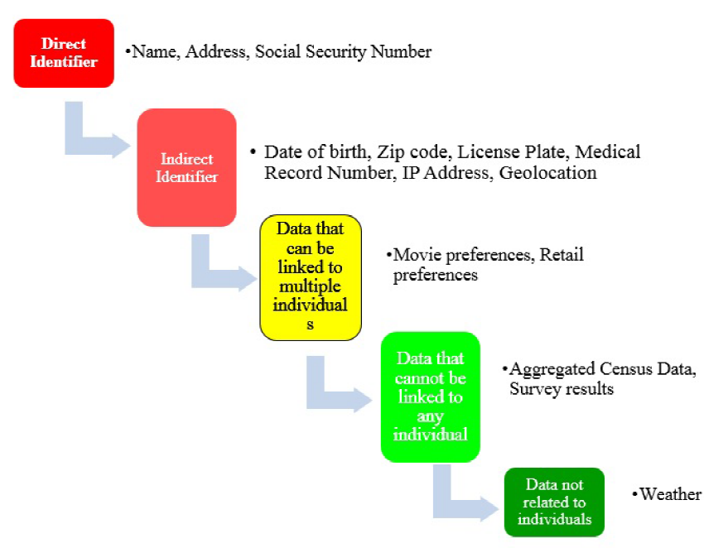
Data De-identification
Adapted from Lubarsky, 2017

Slide 7
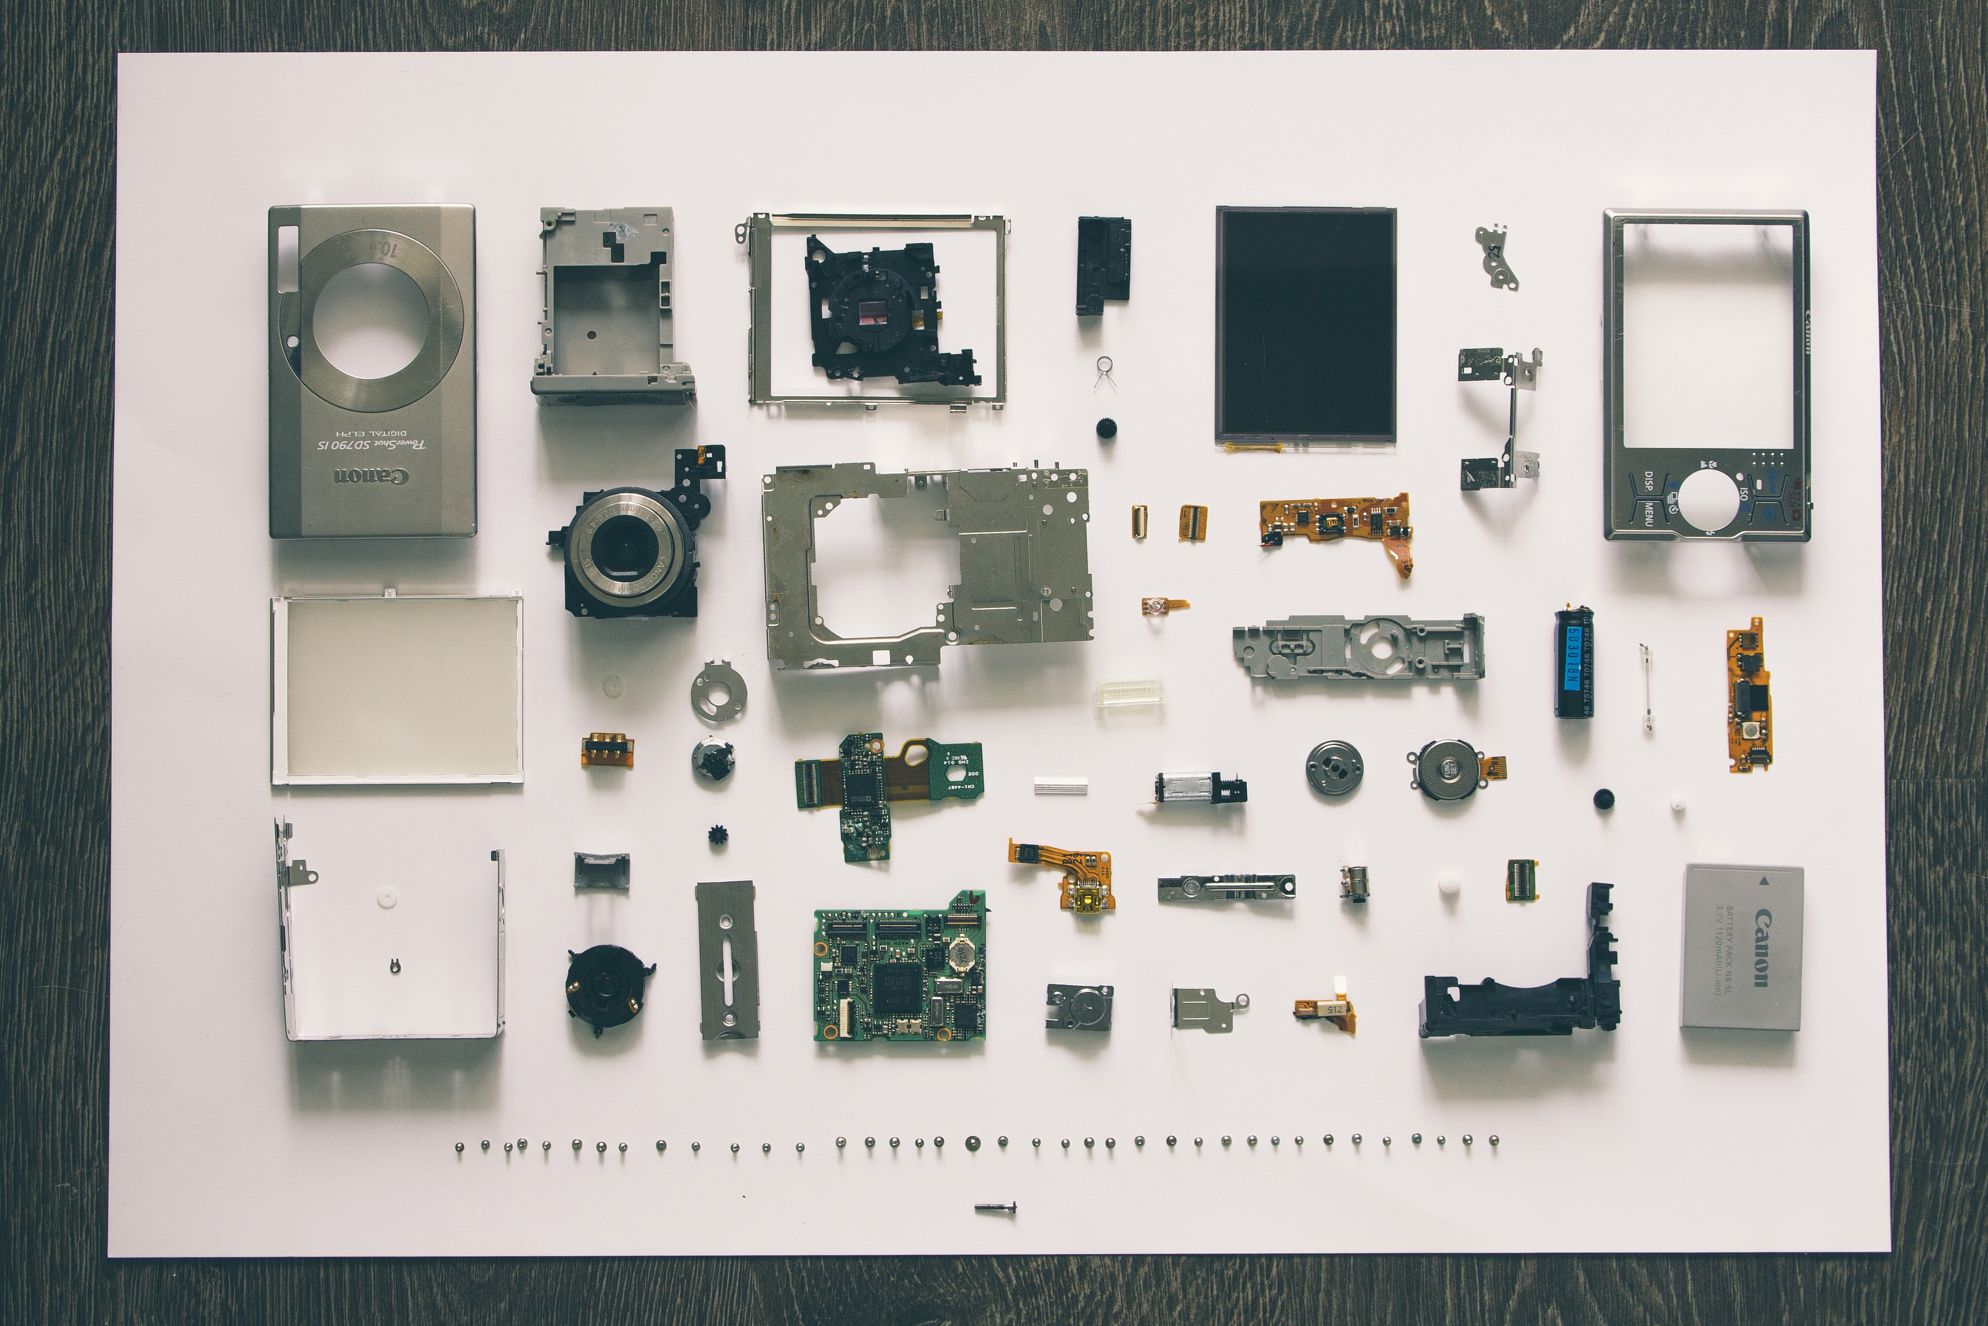
Issue: anonymizing open data and re-identification
Open data is freely manipulated, no restrictions
Recombination and re-identification of the individual
Machine Learning applied to data re-assembly

Slide 8
Response to re-identification
Responding to information held by libraries
“Myth of easy re-identification”
Data sharing agreements which limit secondary use of data
Value of de-identified data sets

Slide 9
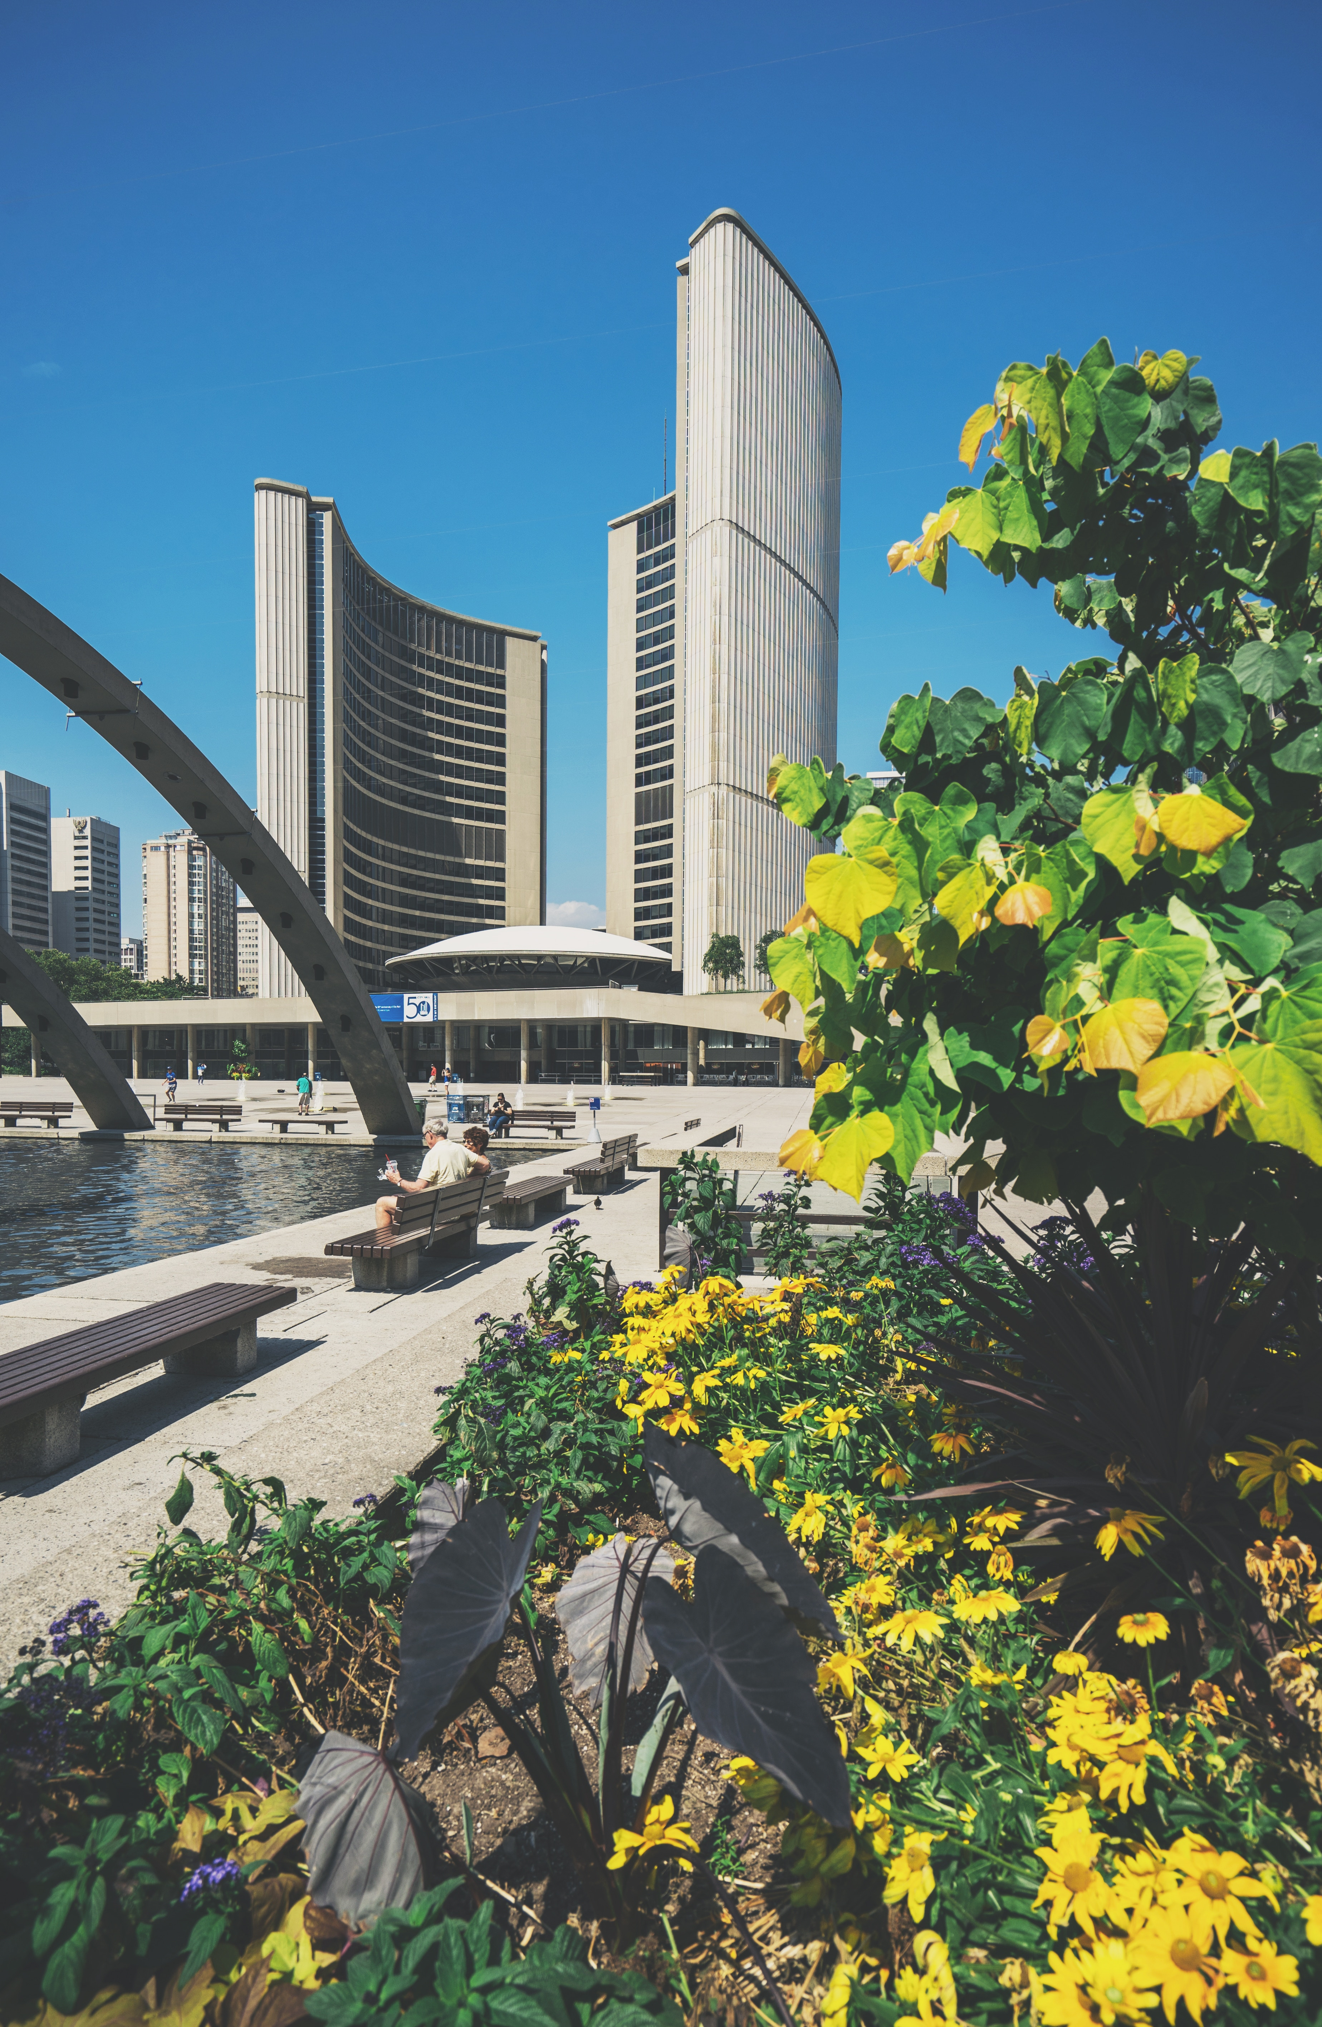
Main Points and Conclusion
Open Data is part of transparent and accountable governance
Today’s techniques of re-identification can nullify scrubbing and compromise privacy, however re-identification is difficult

Slide 10
Questions?

Slide 11
Acknowledgements
Special thanks to Elizabeth Glass, Suzanne Millar, Antonia Castro and Carmen Ho for their support in helping to prepare this presentation.
Thank you to Michelle Arbuckle and the OLA conference organizers for their support
All photos are sourced, license free from www.unsplash.com: Thank you to contributors Christophe Hautier, Jeremy Perkins, Ashkan Fourzani, Rawpixel, Jesus Rocha, Vadim Sherbakov, Jack Kaminski, Paul Hanaoka, and Scott Webb.
Scott Adams Inc., 2013. https://bigdata-madesimple.com/dilberts-20-funniest-cartoons-on-big-data/

Slide 12
References
Cavoukian, Ann, and Khaled El Emam. Dispelling the Myths Surrounding De-Identification. Information & Privacy Commissioner of Ontario, June 2011, fpf.org/wp-content/uploads/2011/07/Dispelling the Myths Surrounding De-identification Anonymization Remains a Strong Tool for Protecting Privacy.pdf
City of Toronto. “Open Data Master Plan.” Open Data Master Plan - City of Toronto , City of Toronto , 10 Jan. 2017, www.toronto.ca/city-government/data-research-maps/open-data/open-data-master-plan/.
De Montjoye, Yves-Alexandre et al., “Unique in the shopping mall: On the reidentifiability of credit card metadata”, (2015) 347: 6221. Science.
Lubarsky, Boris. Re-Identification of “Anonymized” Data. (2017) 202 Georgetown Law Technology Review.
Ohm, Paul. Broken Promises of Privacy: Responding to the Surprising Failure of Anonymization. (2010) 57
UCLA L Rev 1701.

