Slide 1
Teaching privacy: Making it fun, Engaging & Empowering Paula Cardozo, University of Lethbridge February 1, 2018
Notes:
Paula (after Jonathon)
- Jonathon makes a compelling case for public libraries and privacy
- I’ll not only be speaking from an academic library perspective, but also from a limited time & resources POV.
– before falling into libraries, I worked in the Freedom of Information & Protection of Privacy office for an Ontario gov’t ministry.
I’ve used the privacy training I received there in every job I’ve had since. My initial interest was in surveillance, specifically cameras in libraries.
When I arrived at U of L 2 years ago & was asked to do a guest lecture in a computer science course the main focus was on surveillance. When I logged into the Moodle discussion it was clear I had made an impression which is good, but I had also scared hell out of some them which was bad.
I started to question my approach. I didn’t want to scare students – I wanted to engage them, empower them.
Despite negative things I read about millenials, many students I talk to ARE interested in privacy. They’re in school, racking up debt, about to enter a precarious labour market. They do care about their online reputation – and that’s a way in.
I also encounter “I have nothing to hide” and that speaks to the confusion of privacy with secrecy.
It is to both of these perspectives that I try to speak to in guest lectures that I’m invited to in different disciplines.

Slide 2
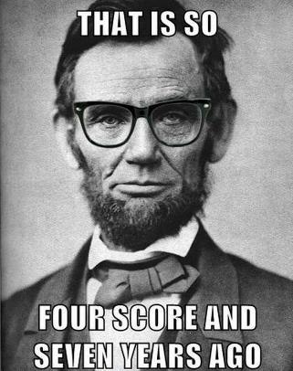
Does Privacy need a make-over?
Privacy has been cast as “old fashioned”
Anti-progressive
Expensive, not good for the economy
A threat to security
http://www.harvardlawreview.org/wp-content/uploads/pdfs/vol126_cohen.pdf
Notes:
Right around the same time that I had my epiphany about not terrifying our students, I encountered an article that had a profound impact on me.
It allowed me to cross a threshold in the way I was conceptualizing privacy teaching & it inspired me to change my approach.
Julie Cohen in the Harvard Law Review called “What is Privacy For?”
Privacy is often framed as a negative, old-fashioned notion that is at odds with other values. When up against these other values, it often loses.
It is to these assumptions about privacy that we can frame new perspectives that speak powerfully to agency and self-determination.

Slide 3
Julie Cohen “What Privacy is For”
Privacy shelters dynamic, emergent subjectivity from the efforts of commercial & government actors to render individuals & communities fixed, transparent & predictable.
A society that values innovation ignores privacy at its peril, for privacy also shelters the process of play & experimentation from which innovation emerges.
Notes:
When setting the context prior to the class discussion slides, I try to plant this seed.
What IS privacy for? What are the benefits? Why does it make possible?
Think about how your behaviour – how it can change when you know you’re being watched.
We require room – to play, to experiment, to question.

Slide 4
IFLA Code of Ethics for Librarians & other Information Workers (2012)
3.3 Privacy, secrecy and transparency
Librarians and other information workers support and participate in transparency so that the workings of government, administration and business are opened to the scrutiny of the general public. They also recognise that it is in the public interest that misconduct, corruption and crime be exposed by what constitute breaches of confidentiality by so-called ‘whistleblowers’.
https://www.ifla.org/publications/node/11092
Notes:
Many of our professional associations cover privacy as a core value of our profession, some of these statements going back many decades.
Often, they cover the need to protect the privacy of our patrons. Typically they speak to what happens in our buildings.
This statement by IFLA relates to points Jonathon was making as it also positions us outside the library and in society as a group of professionals uniquely qualified to advocate for privacy.
Notice the section on whistleblowing and the fact that it pre-dates the breaking of the Snowden story.

Slide 5
Information Literacy Competency Standards
for Higher Education
Standard Five
The information literate student understands many of the economic, legal, and social issues surrounding the use of information and accesses and uses information ethically and legally.
1. a) Identifies and discusses issues related to privacy and security in both the print and electronic environments
Notes:
In addition to our values statements, we have other guidelines that illustrate an evolution.
Here’s the old ACRL standard that speaks to privacy. The “IL” student “understands” and “discusses” issues around information. The student is rather static and the relationships with information centred around consumption – their consumption of information. Looking back, it feels a bit passive.

Slide 6
Framework for Information Literacy for Higher Education
Information Has Value
Knowledge Practices
Learners who are developing their information literate abilities make informed choices regarding their online actions in full awareness of issues related to privacy and the commodification of personal information.
Dispositions
Learners who are developing their information literate abilities: see themselves as contributors to the information marketplace rather than only consumers of it
Notes:
Fast forward to the new Framework and we see a very different perspective, not just about privacy, but about the patron.
The learner is developing, always. They’re not merely consuming, they’re making choices, they’re aware.
Additionally, they’re not just consumers but creators. There’s a lot more agency here.
Coupled with the Cohen article, the FW changed my approach.

Slide 7
Notes:
- During my guest lectures, I often briefly cover the Charter’s position on privacy.
- While not mentioned in the Charter itself, the SCC has handed down rulings that protect this right - although it is not absolute and must be balanced against other rights & responsibilities.
- Usually we’re looking at Section 8 which is meant to protect citizens against unreasonable search & seizure. It can also apply to Section 7 on liberty & security of the person – our dignity.
- This is a good opportunity to discuss what happens when privacy collides with other rights & values – and something I explore with the students during the discussion section with them.
And, of course, as this slide alludes to, you have an opportunity to open up a conversation about C51.
This is a good opportunity to bring up our responsibility in speaking to privacy – you don’t need to be a constitutional lawyer or an IT expert. If you’re like, and suffer from the odd bout of imposter syndrome, let it go. We’re uniquely qualified and positioned to speak and to advocate.

Slide 8
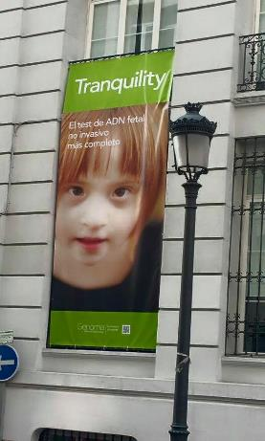
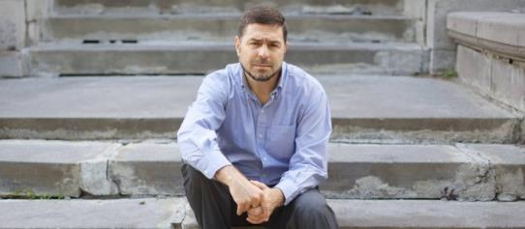
What if it happened to you?
http://www.huffingtonpost.com/2014/01/20/mike-seay-officemax-lette_n_4632822.html
http://soheresus.com/2015/06/12/down-syndrome-genoma-copyright-infringement/
http://www.theglobeandmail.com/news/national/how-canada-failed-citizen-maher-arar/article1103562/?page=all
Notes:
The following slides are some of the examples I’ve used as discussion starters. Here are a few examples.
Using empathy to connect students to privacy has been an interesting strategy:
When someone says they have nothing to hide or to lose by a privacy breach, it is often because they haven’t been in that situation. Here are 3 examples of hurtful/harmful breaches.
Picture used without permission by a fetal testing company in Europe. Pic is from a Mom’s blog about her daughter with DS (also battling cancer…). Company called out, took pic down.
Mike Seay’s letter from Office Depot. Example of a mail merge gone wrong (info about his daughter’s death on the envelope – as if he needed to be reminded of this event via mail…). Why does “Big Data” need that much info?
What if the info is wrong? What if governments are sharing it? What if you’re detained and tortured? Ask Maher Arar…

Slide 9
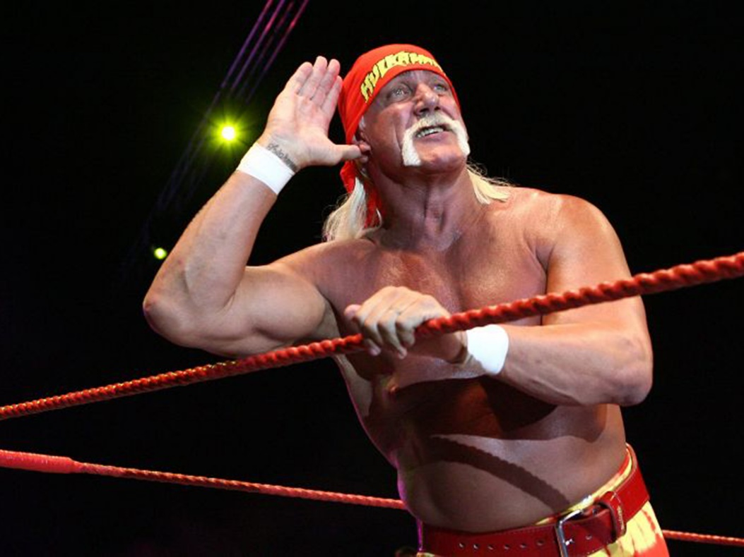
Who “deserves” privacy?
Image retrieved from: http://static.independent.co.uk/s3fs-public/thumbnails/image/2015/07/03/22/33-Hulk-Hogan-Get.jpg
Notes:
Surprisingly, one of the most successful discussion slides has been Hulk Hogan!
Do public figures “deserve” privacy?
Decision in which a jury awarded Hulk Hogan a huge settlement from Gawker for their decision to release a tape of him having sex with his former best friend’s wife (recorded without his knowledge & released without his consent)
This is an example, in the U.S., of a person’s right to privacy coming up against the constitutional right of “freedom of the press”
But is this really “newsworthy” ? Hogan’s lawyer argued that the sex in questions was a private act between private people; therefore, the First Amendment “Freedom of the Press” argument shouldn’t apply.
Very interesting to see how quickly the students start arguing the points. Often, I don’t have to do much prompting.
https://www.rollingstone.com/sports/features/why-the-hulk-hogan-sex-tape-verdict-matters-20160322

Slide 10
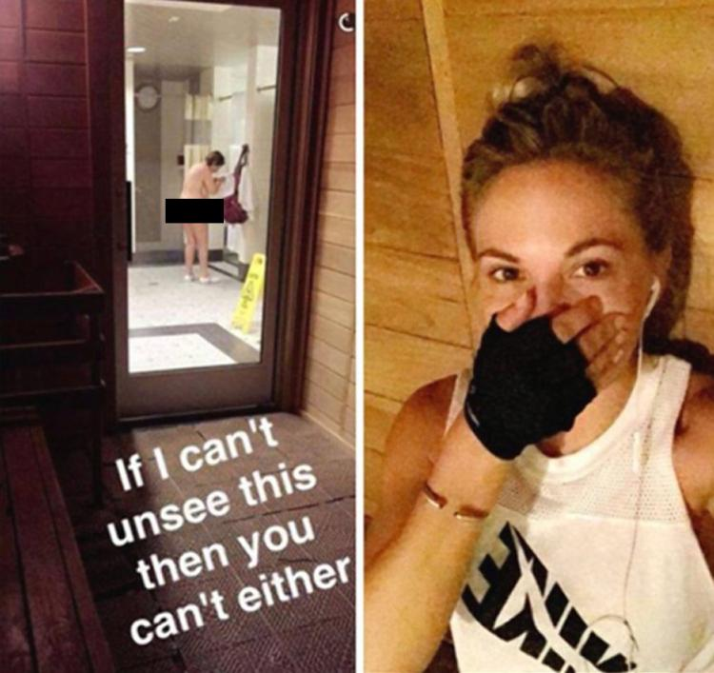
Consequences?
To the woman she photographed?
To other gym users?
To Dani Mathers herself?
Notes:
Another example that prompted a strong reaction was Dani Mathers. I recently changed this one up a bit to talk more about the consequences – this was on the feedback of a computer science prof who wanted to explore the long-term consequences of a quick, yet terrible, decision by Mathers.
Mathers thought she was sending a direct msg to a friend, instead it went out over her social media channel
Post went viral, Mathers faced widespread condemnation/death threats/job loss/criminal charges
Not sentenced to jail time but instead to 300 hours of community service & probation
Her interviews seems to show her remorse, particularly her regret for hurting the woman she shamed; however, she’s not completed her service & could be sentenced to 45 days in jail
Real life consequences for victim and for Mathers

Slide 11
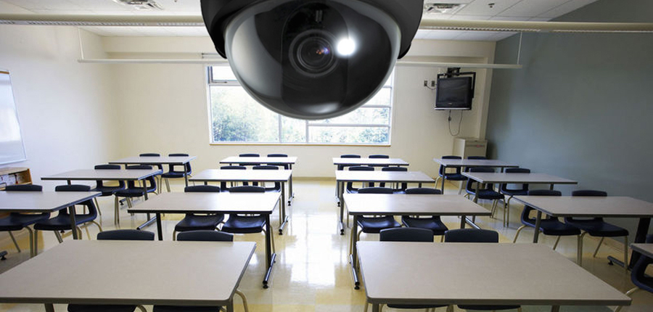
The Case for Class Cams?
Argues that cameras can be used to aid professors’ development as good teachers, protect students from abusive profs & fellow students
Also argues that sometimes profs need protection from students. What do you think?
https://www.insidehighered.com/views/2016/07/08/lets-put-cameras-classroom-protect-professors-narcissistic-students-essay
Notes:
This is a good discussion piece with my Education students; however, it can be carried over to any higher ed class.
- An opinion piece by a prof in Inside Higher Education, argued that classrooms should have cameras.
- Briefly summarize the context, prompt them when needed, but let them do most of the unpacking.

Slide 12
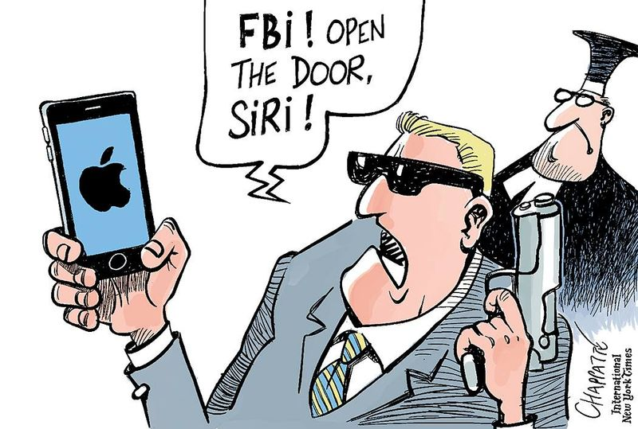
Apple the Altruist?
Image from http://jeffreyhill.typepad.com/.a/6a00d8341d417153ef01b7c81a13b2970b-800wi
Notes:
When FBI & Apple got into it a while back, this was a very good discussion example.
Students debated privacy vs. security, particularly when terrorism is being considered
Also a good opportunity to talk about the profitability of privacy. Does Apple really care about their customers privacy – or were they worried they’d lose cell phone buyers to Samsung?
What about the power we have not just as consumers but as citizens? Opportunities for agency?
http://www.cnet.com/news/the-apple-vs-fbi-drama-isnt-close-to-over-yet/

Slide 13
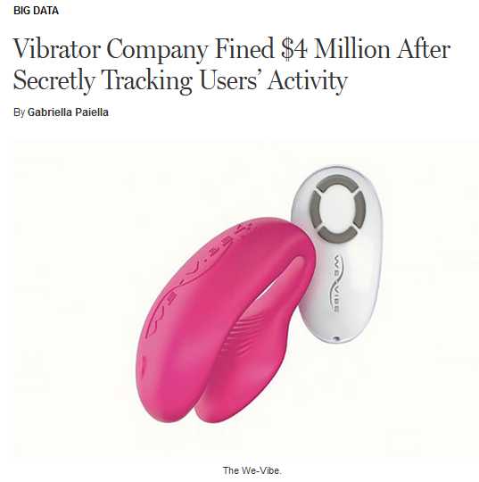
How a Sex Toy Screwed Itself…
Without notifying users, the company tracked & transmitted:
Date & time of use
Vibration intensity & pattern
Temperature of the device
Info tied to personally identifiable email addresses
A failure to enact basic “privacy by design” can have a big impact on a company’s reputation and profits
http://nymag.com/thecut/2017/03/vibrator-company-fined-usd4-million-for-tracking-user-activity.html
Notes:
I often try to find current discussion examples, particularly with Canadian content, nevertheless, even with my academic freedom, I had second thoughts about this slide!
-

Slide 14
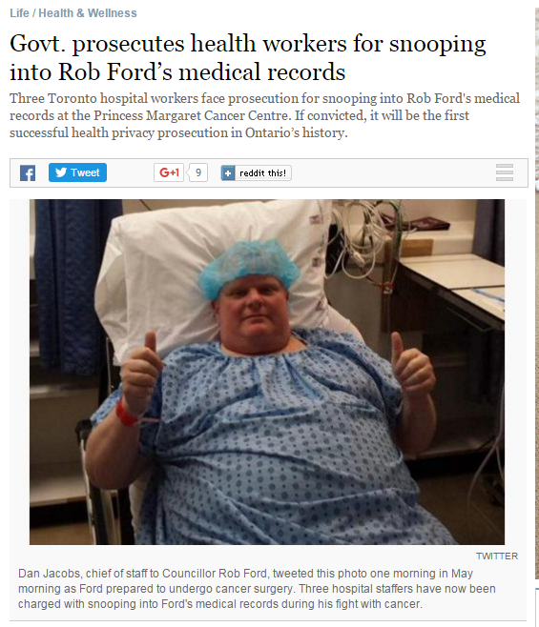
Rob Ford’s Health Records
http://www.thestar.com/life/health_wellness/2015/07/08/govt-prosecutes-health-workers-for-snooping-into-rob-fords-medical-records.html
Notes:
This is a good example when going into Health Sciences classes.
We have a Nursing program at Uleth & I often ask the students if they cover privacy when they’re speaking about patients, ethics, etc.
An even more serious example of a health records breach occurred in my former town, North Bay, when a local Nurse lost her job for accessing about 6,000 records for patients she wasn’t involved in treating.

Slide 15
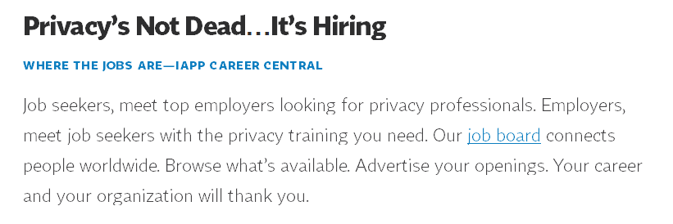
Did you know ULeth IT offers free training?
Security Awareness Course
Phishing Course
Data Storage Standard Course
Encryption Course
http://www.uleth.ca/information-technology/security/information-security-courses
Notes:
Another thing we discuss is how marketable privacy skills & knowledge are – my privacy training has not only been useful in every job I’ve ever had, but I believe it has helped me get some of those jobs.
Also an opportunity to promote privacy experts in your community – whether it is on campus or in another library.

Slide 16
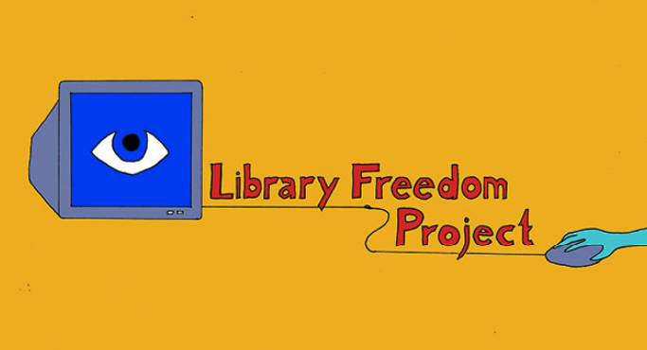
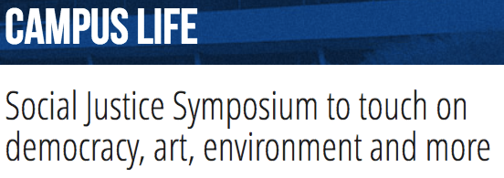
Seek out your Allies and Opportunities
Notes:
One thing I love about the LFP is how they collaborated with skilled/knowledgable people outside of libraries. We’re not lawyers, IT security experts – and we don’t have to be. This will help you let go of your imposter syndrome and focus on what you can do.
This inspired me to bring together a cross-campus panel, with a WGST/Legal scholar and an IT Security specialist, for a proposal to speak at a teaching conference on privacy. We’ve since collaborated on displays, marketing on-campus privacy training, and a possible privacy book/video club.
When I was approached to speak at a Social Justice symposium, in my section on libraries I made sure to link privacy to SJ, and how libraries are advocates.
Speaking of allies and opportunities, we see this session as an opportunity. We’ve discussed the need for a cross-Canada network of libraries and other allies. Perhaps we could take those first steps together today.

Slide 17
Interested in Privacy?
Let’s look into creating a cross-Canada group of library workers to share resources and support one another.
Email Paula Cardozo at paula.cardozo@uleth.ca

