Slide 1
Preparing for the Journey: Walking the Path Towards Truth and Reconciliation
Presented by Jamie Lee Morin (York University Libraries), Melanie Ribau (Toronto Public Library), Desmond Wong (University of Toronto Libraries)

Slide 2
Desmond Wong, Outreach Librarian
University of Toronto Libraries

Slide 4
Call to Action no. 57
We call upon federal, provincial, territorial, and municipal governments to provide education to public servants on the history of Aboriginal peoples, including the history and legacy of residential schools, the United Nations Declaration on the Rights of Indigenous Peoples, Treaties and Aboriginal rights, Indigenous law, and Aboriginal–Crown relations. This will require skills-based training in intercultural competency, conflict resolution, human rights, and anti-racism

Slide 5
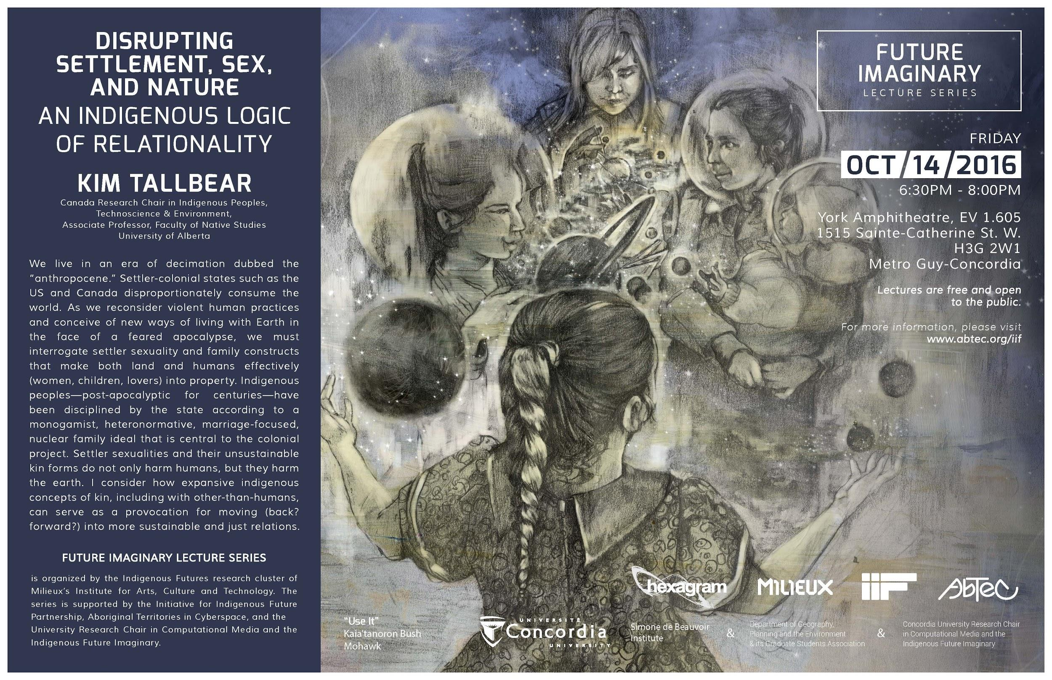
Retrieved from: http://abtec.org/iif/wp-content/uploads/2016/10/FILS-Kim-Tallbear-11x17-highres.jpg

Slide 7
Melanie Ribau, Senior Services Specialist - Indigenous Community Connections & Partnerships,
Toronto Public Library
Notes:
Hi everyone. As Don mentioned in the introductions, I’m a first generation settler who really is very lucky to be working in this capacity, meeting and building relationships with members of the diverse Indigenous communities in Toronto. I have learned a lot, and continue to learn a lot, from and in the community. Any knowledge and understanding I have comes from the community, and has graciously and generously been shared with me by them. I’d also like to acknowledge all of the Indigenous librarians and professionals, some of whom may be in this room, and whom I’ve had the pleasure of meeting over the years. I have also learned a lot from you, and I always feel reinvigorated when I’m in your company. Having said that, my knowledge and understanding are still spotty and imperfect and I still have many blind spots. I come to you today, my peers in this profession, both Indigenous and non-Indigenous, in humility, to share what I’ve learned, and am continuing to learn.

Slide 8
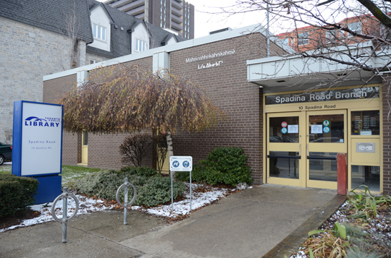
Spadina Road Branch
Photo credit: First Story Toronto
(Retreived from https://firststoryblog.wordpress.com/2013/03/11/toronto-public-library-spadina-road-branch/)
Notes:
I’d like to start by offering some background information on Indigenous services and collections at TPL pre-TRC, and then talk about some of the things that have been happening there since the release of the TRC Calls to Action.
Historically, the Spadina Road Branch has been the seat of Indigenous programming and collections at TPL. 40+ year ago, the Native Canadian Centre of Toronto approached the Toronto Public Library about opening a branch dedicated to serving the needs of the Indigenous community in the city. The branch opened on July 16, 1977, at 10 Spadina Rd. in a building owned by Native Canadian Centre of Toronto.
The mandate of the branch was to serve the local community and house a special collection with a focus on Indigenous content. It was the first public library in Toronto dedicated to doing so.

Slide 9
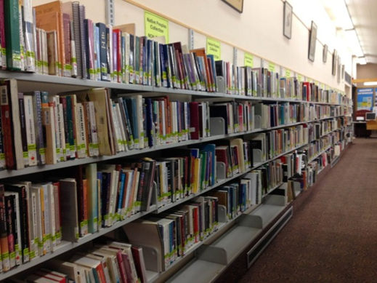
Native Peoples Collections at TPL
Photo credit: Melanie Ribau
Notes:
In 1980, TPL purchased the building at 10 Spadina Rd. from the NCCT and today the branch continues to house one of two Native Peoples’ Collections. Even up until today, this is one of the best examples of partnership between TPL and Toronto’s Indigenous community – the community made a request of the library and the library worked with the community to make it happen.
[At the Spadina Road branch, the Native Peoples’ Collection contains over 5000 items, including adult, teen and children’s books, as well as CDs, DVDs, magazines and newspapers. The collection at the North York Central Library opened in 1987 and contains over 3500 adult fiction and non-fiction materials.
Although the Spadina Road branch is still often frequented by members of the community, we know that Indigenous families and communities are spread out across the city and that the location of the branch and the collection in the downtown core posed barriers for people and families living in other parts of they city. We knew we had to do a better job at meeting the wants of the community at their point of need.
As part of TPL’s response to the TRC Calls to Action, these focus collections are currently being expanded to six more locations (CC, DR, MS, PL, SJ, WY) in areas of the city where Indigenous families and communities live. There are also efforts to increase the visibility of books with Indigenous content and by Indigenous authors at all branches across the city.]

Slide 10
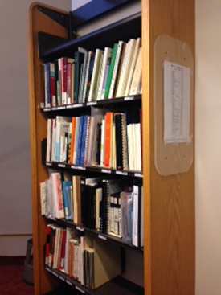
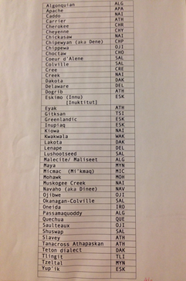
Indigenous Languages Collections at TRL
Photo credit: Melanie Ribau
Photo credit: Melanie Ribau
Notes:
The Indigenous Languages Collections at the Toronto Reference Library was also another pre-TRC initiative that helped to support the needs of the community, particularly in the area of language revitalization. One collection contains Indigenous language dictionaries and texts; and the other is comprised of Indigenous language learning materials on cassette and CD. Over 40 Indigenous languages and language families are represented in these collections including Algonquin, Cree, Mohawk, Anishinaabemowin, and Oneida.

Slide 11
TPL Strategies for Indigenous Initiatives
1. Breaking Down Organizational Barriers
2. Indigenizing Library Spaces: Physical and Virtual
3. Incorporating Indigenous Content into TPL Programming
4. Improving Access to Indigenous Content through TPL Collections
5. Enabling and Empowering Indigenous Communities
6. Building Capacity and Staff Competency
Notes:
Up until 2015, aside from some programming, outreach and internal committees, this was the extent of TPL’s more formalized initiatives with Toronto’s Indigenous communities. With the release of the TRC Calls to Action, TPL looked to work in more meaningful and ongoing ways with the community in Toronto. The first step in this direction was TPL’s Strategies for Indigenous Initiatives board report, which was endorsed by the Toronto Public Library Board on April 18, 2017. The purpose of the document was to respond to the TRC’s 94 Calls to Action, and to inform the direction of Indigenous Initiatives at TPL going forward.
The Strategies for Indigenous Initiatives were developed for consultation with Indigenous communities and service providers in Toronto, and informed by the CFLA-FCAB TRC Report and Recommendations, an external scan of initiatives at other public libraries, the Toronto Aboriginal Research Project Report, conversations with community members, and the feedback I received from the community while working at the Spadina Road Branch. So far, the strategies have been presented to the Aboriginal Advisory and Planning Committee, an advisory group to Toronto’s Children’s Services Dept., and to TPL’s Indigenous Advisory Council. They will also be presented to Toronto City Council’s Aboriginal Affairs Committee on February 15, next month.
In this document, there are 42 strategies listed under the following six categories:
1. Breaking Down Organizational Barriers
2. Indigenizing Library Spaces: Physical and Virtual
3. Incorporating Indigenous Content into TPL Programming
4. Improving Access to Indigenous Content through TPL Collections
5. Enabling and Empowering Indigenous Communities
6. Building Capacity and Staff Competency
The items under these categories range from posting land acknowledgement statements at branches, to supporting Indigenous language programming, to recruitment and staff training.
Professional Development and Training for Public Servants
#57. We call upon federal, provincial, territorial, and municipal governments to provide education to public servants on the history of Aboriginal peoples, including the history and legacy of residential schools, the United Nations Declaration on the Rights of Indigenous Peoples, Treaties and Aboriginal rights, Indigenous law, and Aboriginal–Crown relations. This will require skillsbased training in intercultural competency, conflict resolution, human rights, and anti-racism. (p. 7)
Museums and Archives
#69. We call upon Library and Archives Canada to:
i. Fully adopt and implement the United Nations Declaration on the Rights of Indigenous Peoples and the United Nations Joinet-Orentlicher
Principles, as related to Aboriginal peoples’ inalienable right to know the truth about what happened and why, with regard to human rights violations committed against them in the residential schools.
ii. Ensure that its record holdings related to residential schools are accessible to the public. iii. Commit more resources to its public education materials and programming on residential schools. (p. 8)

Slide 12
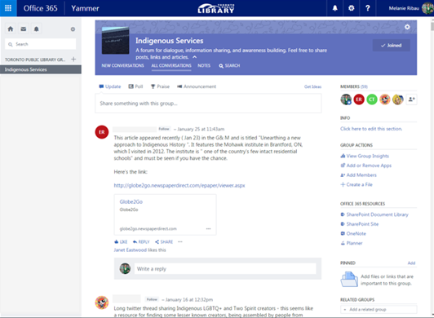
Staff Training, Competency, & Capacity Building
Notes:
One of the main areas of focus for TPL has been on providing more opportunities for staff education.
This focus led to the creation of a Yammer group to provide staff with a forum for awareness building, information sharing, and dialogue. Staff are encouraged to post articles, links and resources that help to support understanding and awareness.
In the past year, TPL has also implemented Indigenous Cultural Competency training delivered by the Ontario Federation for Indigenous Friendship Centres, and which is mandatory for staff at all levels. As part of TPL’s training opportunities this fall, staff were also given a tour of the ROM’s Anishinaabeg: Art & Power exhibit, which was led by J’net AyAyQwaYakSheelth, the Indigenous Outreach and Learning Coordinator at the ROM.
This year, we have a few new opportunities coming up for staff, including training sessions on treaties, Kairos blanket exercises, a high-profile keynote speaker, and First Story bus tours. Some of these staff training initiatives have also been used for TPL’s public programming.

Slide 13
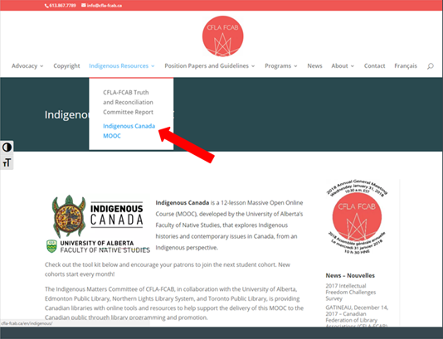
UofA’s Indigenous Canada MOOC
Notes:
Staff are also being encouraged to take Indigenous Canada, a 12-lesson MOOC created by the University of Alberta’s Faculty of Natives Studies, that explores Indigenous histories and contemporary issues in Canada from Indigenous perspectives, as a follow-up to the mandatory all-day training. Branch Heads and supervisors have been directed to provide 2-3 hours of scheduled work time, once a week for 12 weeks, for interested staff to complete the course.
This online course is being promoted by the CFLA-FCAB Indigenous Matters Committee as a programming and staff training opportunity for libraries across Canada, and a kit has been created with ideas on how libraries can activate this MOOC in their branches. An Indigenous Canada Learning Circle program for the public was piloted at the Reference library this past fall as part of this initiative.

Slide 14
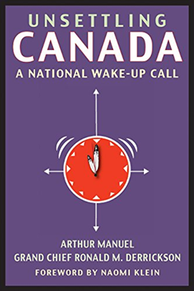
Unsettling Canada
●Unsettling150.ca - Canada Must Read
●One Book campaign
●Book club sets purchased
●Book club programs
●Unlimited eBook checkouts
●Over 850 downloads during a 2 week span
●23 more holdable copies added to the system collection
●The Reconciliation Manifesto by Arthur Manuel
(Unsettling Canada 150 – 2018 Canada Must Read title)
Notes:
In the fall, as part of TPL’s Resist 150 programming, we ran a one book campaign for Unsettling Canada by Art Manuel, an Indigenous rights activist who passed away last year. We ran this one book campaign specifically because it was Unsettling Canada 150’s selected title for their Canada Must Read initiative. Part of our campaign included purchasing book club sets and more holdable copies for the system, running book club programs at multiple branches across the city, and working with the publisher (Between the Lines) to provide unlimited ebook checkouts to TPL cardholders through OverDrive for a two-week period in October. This one book campaign saw over 850 downloads of the ebook during a two week span and over 250 checkouts of print copies of the book over the last four months. The Canada Must Read title for 2018 is The Reconciliation Manifesto, also by Arthur Manuel. Libraries can help promote this title through their programming, book clubs, and social media channels.

Slide 15
Ojibwe Language Story Time
Learn how to incorporate Anishnaabemowin in your young one’s life. We will share songs, games, ideas, experiences, and laughs. Discover how to substitute simple phrases in popular children’s books to enrich your child’s language skills. Learn about the books available from the Toronto Public Library to support your growth together.
This program is aimed at children age 0-5 along with their families and caregivers. Everyone is welcome, and no language knowledge is necessary. Drop in!
Rochelle is an Anishnaabe mother living in Toronto. These workshops are part of her efforts to create more opportunities for children in Toronto to interact with Anishnaabemowin.
Notes:
The Ojibwe Language Story Time is another Indigenous-led initiative that is new to TPL. In the fall, Rochelle, an Anishnaabe mother living in Toronto, approached one of the branches in the east end with the idea of running Ojibwe language programming for children. The branch offered her the space and Rochelle has been delivering story time sessions since early December. The program is aimed at children ages 0-5 along with their families and caregivers, and includes songs, games, and stories that teach parents and children Anishinaabemowin words and phrases that they can use in their daily lives.

Slide 16
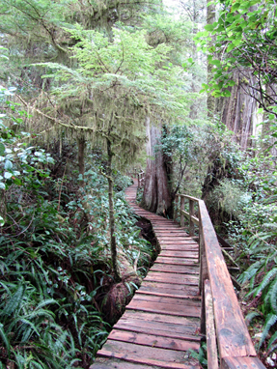
Preparing for the Journey
● Education and Awareness
● Meaningful relationships built on mutual respect and reciprocity
● Time
Photo credit: Melanie Ribau
Notes:
I’d like to close my portion of this presentation with a few thoughts and that is that there are three key things needed for this journey: education and awareness, meaningful relationships built on mutual respect and reciprocity, and time. We can’t begin this journey without them.
In this post-TRC environment, institutions and people have been quick to move to Reconciliation, bypassing the first and crucial part of this journey: the Truth. There can be no Reconciliation without it. One of the most impactful things libraries and library professionals can do to respond to the TRC Calls to Action is to educate themselves and provide opportunities for library users to learn as well. For non-Indigenous professionals, that needs to be one of our primary duties and responsibilities. We need to think critically about our institutions, and that’s going to involve swallowing some hard truths. Having said that, don’t put the onus of educating yourself on the back of the Indigenous community. There are many opportunities out there for educating yourself that doesn’t put the community in the awkward position of having to educate you. As Cherie Dimaline noted in an interview with Publishing Perspectives (Nov. 3, 2017), “We need better educated and positioned allies, and literature is one way to make this happen.” (Retrieved from: https://publishingperspectives.com/2017/11/indigenous-writers-canada-interview-author-cherie-dimaline/)
As for meaningful relationships, this will need to be built up gradually and organically over time. It can’t be rushed or forced. Cherish and value those relationships more than your institution and its policies. Put them first. Remove barriers so that the community can do what it wants and needs to do. This is about the community, not about our institutions. One-off approaches and initiatives don’t build relationships. They need to be built slowly and carefully, over time.
Finally, it’s not about the timelines. Things should take as long as they need to take in order to do them right and in a way that is meaningful and respectful. One of the most frequently asked questions I get about Indigenous initiatives at TPL is how long things will take to do. My response is that I’ll be dead and we’ll still be working on them. Both learning and relationship building take time, and there are no blanket, quick-fix answers. There will be ambiguity and uncertainty along the way, but it’s a journey that we need to commit to. There is no other way.
[I’d like to end with a reading of an excerpt from Leannne Betasamosake Simpson’s book As We Have Always Done: Indigenous Freedom Through Radical Resistance, published in 2017 by University of Minnesota Press. This quote is found on p. 13:
“I was suspicious of Dr. Driben in the beginning. He wasn’t Native, he was an anthropologist of all things, but he had created these maps before with other Nishnaabeg communities. Sitting in his windowless cement office in the basement of a building at Lakehead University eating subs, I could tell by the details on the maps that Elders trusted him. I could tell by the bunker-like nature of his office far removed from the upper echelons of the university that perhaps the university didn’t. This boded well for our relationship.
Paul did something that has stayed with me and has always informed my approach to working with communities and to research. He was invited into the community to do a specific task, which in the end he delivered, but he actively and continually divested himself of the false power the academy bestowed upon him when he drove onto the reserve. He asked the Elders if they thought the project was a good idea. They said it was. He asked them how best to proceed. They told hm. He asked them if they would be the decision makers. They agreed, and then they were, and he got out of their way.”]
Thank you. Now I’d like to call Jamie up to the podium.

Slide 17
Jamie Lee Morin, Indigenous Digital Collections Project Assistant
York University Library

Slide 18
Community perspective
There is absolute and incredible value in creating and maintaining partnerships between your institutions and Indigenous communities in your area (and beyond).
If you are interested in learning more but are unsure how, simply begin.
Examine how your institutions may be inaccessible to Indigenous communities, and work on increasing accessibility and visibility.
Recommendation: to read and actively explore the full implementation of the Canadian Federation of Library Association’s Truth and Reconciliation Committee Report and Recommendations.
Notes:
· Libraries are institutions of knowledge keeping, gathering and sharing, something which is both valued and difficult in our communities. In the past, libraries have helped to enforce the erasure of Indigenous ways of knowing. But for our communities, libraries are also incredibly valuable because they may also aid in the reclamation of Indigenous knowledges and histories. As a Métis woman who worked and continues to maintain a strong connection with the Indigenous community in Toronto, the Gathering Place, I can attest to the incredible value of building and maintaining relationships and partnerships. To establish both of these requires more than one meeting. It requires frank discussions on how colonialism has benefitted our libraries, archives, and education systems and has placed Indigenous peoples and their knowledges at a disadvantage which may make folks feel uncomfortable (and it is okay to feel uncomfortable so long as the discomfort is used as a catalyst for positive, meaningful change!). And, it looks like meaningful discussions together on how to create meaningful changes to walk together in the true spirit in our collective journey to Truth and Reconciliation.
· If you personally are interested in going along this path and are unsure of where to begin, my word to you is simply this: BEGIN. Ways to begin may look like participating in community events such as attending public pow-wows, going to National Aboriginal Day, or even attending the ImagineNATIVE film festival (or alternatively, hosting events where Indigenous films are screened with discussions afterwards) in your town. Or it could look like attending a KAIROS blanket exercise to understand the sheer horror that was done unto our communities with Indian Residential Schools, or volunteering your time for educational programs (such as tutoring) in our friendship centres. It can even be taking night courses or distance education to learn about Indigenous perspectives. What all of these incredibly diverse actions have in common is that they all carry a component learning about us in our own words.
· The way our communities access libraries can be similar to the average client in your own libraries – to borrow a book, or research assistance, or even checking the web. However, libraries also act as lifelines for community members who may be from out of town, from another institution, or have fallen into unfortunate circumstances. Sometimes, our libraries appear to be unavailable and inaccessible to our communities. This can be from anything from how front-line staff approach and talk with Indigenous community members to the frustration of falling in between the cracks for assistance. Meaningful change comes with promoting any access programs you have (such as issuing a temporary username and passcode) or issuing community members no-cost memberships. Meaningful change also means hiring Indigenous folks for every role, from front-line to research and archives and beyond (aka representation). It can also look like librarians who are active allies to advocate creating resources or Indigenize libraries through representation. The CFLA Truth and Reconciliation Committee Report and Recommendations #4 calls for the need to ensure and increase accessibility of the institution for all Canadians; and #6 calls for the recognition and support of Indigenous cultures, languages and knowledges through culturally appropriate space planning among others, and public programming in collaboration with local Indigenous stakeholders (meaning, communities).

Slide 19
Examples of Outreach and Collaborations
The Creation of the Aboriginal Research Portal and the Four Directions Writing Guide, Ryerson University Library and Archives (RULA)
My current work as an Indigenous Digital Collections Project Assistant (with many thanks to Young Canada Works), York University’s Scott Library
Both opportunities are In accordance is the CFLA TRC recommendation #9: to establish living documents “to highlight existing Best Practices of Indigenous Services in libraries, archives, and cultural memory institutions”
This among others has lead me to the hope of becoming an Indigenous librarian, to assist in fulfilling the Canadian Federation of Library Association’s Truth and Reconciliation Recommendations.
Notes:
· Earlier I mentioned about Indigenous representation in staff in libraries. Part of my community work is that I worked on a project in collaboration with Ryerson University Library and Archives (RULA) and Ryerson Aboriginal Student Services (RASS) to create a researching resource mainly for Indigenous students on campus. This resulted with the creation of two separate, living guides. One of them is called the Aboriginal Research Portal, and the other is called the Four Directions Writing Guide. The Aboriginal Research Portal has 6 sections, including the Writing Guide, covering different aspects of Indigenous issues. A good factor in the creation of this portal also examined resources currently available in the library and exploring which resources were not available, and fixing that issue. In terms of the Writing Guide, I wrote it thinking of several different perspectives. I thought about that scared teenager who was writing their first postsecondary level essay. I thought about our mature students who were either at the same point as that teenager, or who had not written in a very long time. I thought about students who needed a refresher. And I thought about anyone seeking to implement Indigenous content into their papers. In essence, I thought back to the community consultations done earlier that year, I looked at the notes, and I placed my heart and my intentions into this. It resulted with a helpful go-to for any folks, regardless of background, in the journey of writing and citing essays.
· Currently, I am employed through Young Canada Works to work at York University’s Scott Library with librarian Stacy Allison-Cassin, where we’re looking at the Mariposa Folk Festival’s Native Peoples Area between 1971 and 1978. One of our goals is to make the information that is gathered accessible to the communities who attended the festival, and to seek guidance about some materials (in terms of appropriateness of sharing etc.). The way we’re planning on making this accessible is through using Wikimedia. If you want to learn about Wikimedia as a tool to generally increase access as a beginning for research, there’s a presentation on that tomorrow.

Slide 20
To conclude
Create and maintain meaningful relationships with Indigenous communities.
This can be done through reaching out to communities, Indigenizing knowledge keeping and sharing spaces and practices,, and through recruiting and keeping Indigenous candidates for the job.
Notes:
To conclude my section, the best way that I know of to help Indigenize libraries and beyond in this time of truth and reconciliation is the create and maintain meaningful relationships with Indigenous communities.
This can be done through community outreach, Indigenizing knowledge keeping and sharing spaces and practices (such as libraries and archives, examining and changing classification systems, and through recruiting and keeping Indigenous candidates for the job.

Slide 21
Zotero
Together we have prepared a group library on Zotero to share some resources that may be of interest. You may view it at:
https://www.zotero.org/groups/trc_library_ola/

Slide 22
Contact Us
Jamie Lee Morin @jme_morin
Melanie Ribau mribau@torontopubliclibrary.ca
Desmond Wong de.wong@utoronto.ca, @desmondcwong

