Slide 1
CLIC for Success! Partnering with your local Chamber of Commerce OLA Superconference January 31, 2018

Slide 2
Speakers
Leslie Fitch (leslie.fitch@mpl.on.ca)
CEO and Chief Librarian,
Milton Public Library
Scott McCammon (scott@miltonchamber.ca)
President and CEO,
Milton Chamber of Commerce
Anne O’Sullivan (anne.osullivan@mpl.on.ca)
Manager, Information Services and Programming, Milton Public Library
Notes:
Maggie Weaver (convener)
Speaker bios:
Scott McCammon
Scott McCammon has been involved in the Chamber of Commerce business for 35 years, including being one of the few to serve both as a volunteer Board Chair and a Chamber staffer. He is currently President & CEO of the Milton Chamber. Previously, Scott was in Executive roles in the Burlington, Hamilton and Ontario Chambers of Commerce. He is one of only three Canadian Chamber Executives to earn the Certified Chamber Executive (CCE) designation from the American Chamber of Commerce Executive Association in Washington. After only a few years as a Chamber manager, Scott received the Executive of the Year Award for Canada and subsequently joined the Council of Excellence. In his limited spare time, Scott enjoys working as a background actor on TV shows and movies, including: Suits; Designated Survivor; Saving Hope; and Pixels with Adam Sandler.
Anne O’Sullivan
Anne O’Sullivan is the Manager, Information Services and Programming at Milton Public Library. With over 12 years experience in libraries, Anne has at one point or another held most public service roles – including shelving, circulation, reference, and children’s services. Prior to her role at Milton Public Library, Anne worked for Calgary Public Library for six years, in different librarian and manager roles both at the branches and Central. She returned to Ontario in 2016 to be closer to family, and she is enjoying getting to know her new community of Milton.
Leslie’s bio 2018
Leslie Fitch has been the Chief Librarian at Milton Public Library since 1996, and first began working in Milton as the Deputy Chief Librarian in 1990. Prior to working in Milton, she was the Chief Librarian at the Town of Haldimand Public Libraries from 1986 - 1990. Explosive growth has dominated her time in Milton, where anticipating, planning for, and responding to the extraordinary opportunities and challenges inherent in this kind of population growth has been a principle driver in the development of the multi-branch MPL system. Being actively engaged in working with local partners, and regional and broader library communities to achieve shared goals has been a pleasure. She has been a member of the Chamber Board of Directors since late 2016.

Slide 3
Goal of this OLA session:
To share details of the partnership between the Milton Chamber of Commerce and Milton Public Library in order to encourage the implementation of similar programs across Ontario.
Notes:
Leslie
You can see here the goal for today’s session:
It isn’t always easy to identify and implement a new partnership direction, especially one that connects meaningfully with the local business community, and so the Milton Chamber of Commerce and Milton Public Library want to share the Milton experience with you.
While the project is still relatively new, and the direction somewhat changed from what was initially anticipated, it can only be considered to be a success in terms of:
value added for Chamber members (this program is available only to Chamber members),
increased visibility of MPL’s resources with local businesses,
and highlights the valuable skill sets library staff bring to the table.
Finally, it is encouraging a depth to networking and interaction among participants not always possible at more social Chamber events.
As a result, we wanted to bring this project forward to the broader library community to try and encourage similar endeavours in your libraries.

Slide 4
Agenda
Provide context for the project
Why partner with the Chamber of Commerce?
What do local small business owners and entrepreneurs need?
How can the public library help meet these needs?
What is CLIC and how does it work?
Questions
Wrap-up and resource take-aways
Notes:
Leslie
It is a pretty straightforward agenda, and there will of course be time for questions, and all of us welcome any follow up queries. I will be saying a few words, along with Scott McCammon, President and CEO of the Milton Chamber of Commerce. Much of the heavy lifting of the project work has been done by Anne O’Sullivan, Manager of Information Services and Programming at MPL, and I can tell you that the success of the project to date is in very large part due to her hard work. As a result, she will provide most of the details about how the project works, and of course that will form most of our discussion here today.
Today we will chat with you about <click through to animate the bullets>

Slide 5
Embedding MPL in the Community
“Librarians have the power to change lives and build community—but to do this, we have to leave our desks, leave our buildings, and show the community what a powerful tool we are.”
“Community Reference: Making Libraries Indispensable in a New Way”, Long, Galston, Huber and Johnson,
American Libraries Magazine
Notes:
Leslie
I’d like to provide a bit of context for this project.
One of Milton Public Library’s key strategic goals is to “Connect the community and encourage collaboration”.
Enhancing community awareness of MPL, encouraging capacity building, and strengthening alignment with partners is key
We all know that we need to get outside the organization, and provide value back to those with whom we partner.
Since MPL has been working closely with the Milton Chamber of Commerce for many years on a number of different projects, it was exciting to think about connecting on a more library specific approach, that added value back to fellow Chamber members. Scott will be talking more about this project from the Chamber’s perspective.
Source:
https://americanlibrariesmagazine.org/2012/06/13/community-reference-making-libraries-indispensable-in-a-new-way/

Slide 6
MPL’s Partnerships
Notes:
Leslie
Everyone here knows that partnerships are a very powerful (and essential) way for the public library to cement our role as a community hub. MPL’s value as a community hub is evident through embedded relationships in Milton, across Halton, and beyond. MPL is a better library system as a result of partnerships, since with them MPL is able to more effectively serve Milton’s diverse and ever-growing community and broaden both the reach and impact of available services and resources.
The partnerships outlined on this page will only grow, especially since MPL has recently filled a newly created FT Community Led Librarian position to further deepen our community connections. Throughout the engagement with partners, it has always been important to lean on the strengths of the partners, and return that strength and capacity where it makes sense to do so
Currently, MPL partnerships provide:
A variety of newcomer and settlement services to our patrons
trained Parent-Child Mother Goose facilitators to offer additional early development programs at the Library
job skills training
Community Development Halton….
A lecture series now in its ninth year as part of the community effort to bring a university campus to Milton (with the Town and Laurier)
Too many connections with the Town of Milton that can be listed here, but include program planning, transit Read and Ride program, closely aligned financial management directions, and critically important approaches to large scale capital building projects
Halton Community Database
Halton Region
Of course,. we also partner closely with the Milton Chamber of Commerce . . NEXT SLIDE

Slide 7
Library / Chamber Partnership
Leslie Fitch, MPL CEO serves on Chamber of Commerce Board
Library staff attend Chamber networking events, such as Business AfterHours and support Chamber initiatives, such as Youth Scholarships
Current partnership has been very fruitful:
What more can we do together?
Notes:
Leslie
When I started working at MPL in 1990, there was already a longstanding tradition of working closely with the Chamber, and the relationship is one that continues to be fostered. MPL CEOs have assisted on the last two Chamber CEO searches (in the very early 1990’s, and again in 2015-16), and have also served as Board and committee members. Participation in key Chamber events by the CEO common, including working groups up to and including Chairing the Chamber’s Showcase event (when last held, this locally focussed trade show covered the floor of a twin pad arena).
A number of library staff, not just the CEO participate, too. In Chamber breakfast and lunch speaker events, business after hours, the Gala, the Golf Tournament, the Incredible Race, Biz to Biz mini-tradeshows and more have all served informally and formally as effective ways to engage one on one with other Chamber members: but we wanted to do more.
Connecting with the local business community is a key goal for many public libraries, and being engaged with Chamber events is a good approach. But finding something that provided value back to Chamber members, and doing so while highlighting not only the depth and breadth of collection materials, but also the excellence of staff’s skills and ability has been a win win on every level. The response vis-à-vis the library has been what we wanted, and you will hear more from Scott about what his thoughts are

Slide 8
Milton Chamber of Commerce
The Milton Chamber of Commerce is a not-for-profit, membership-based, volunteer driven, organization representing over 700 member businesses and individuals. The Milton Chamber’s primary role is advocacy, fostering a business-friendly environment and allowing the free enterprise system to thrive.
Notes:
Scott
Chambers do a lot of work every day to help improve our communities. Some of that is more behind the scenes with advocacy and government relations. Some of it means networking, connecting businesspeople and providing value through benefits programs and various initiatives.
Leslie has mentioned some of the events we do, such as the Business After Hours networking sessions, our Community Awards Gala, and golf tournament. We also have a Sports Celebrity Dinner & Auction in support of our High School Scholarship program, a Supply Chain Summit, a Young Professionals group, and events featuring local, provincial and federal politicians.
We try to have a variety of services to fill whatever niches or interest areas the members have.
And….that is a foreshadowing to the rest of our presentation this morning!

Slide 9
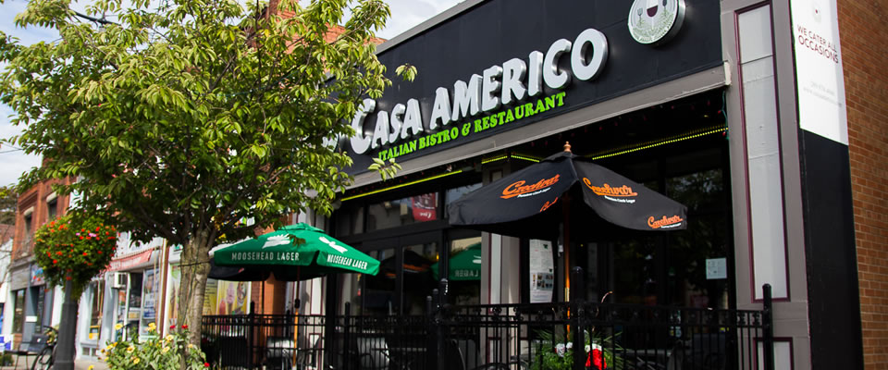
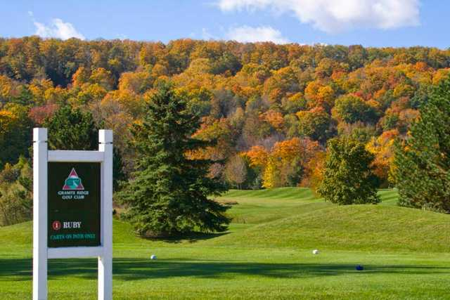
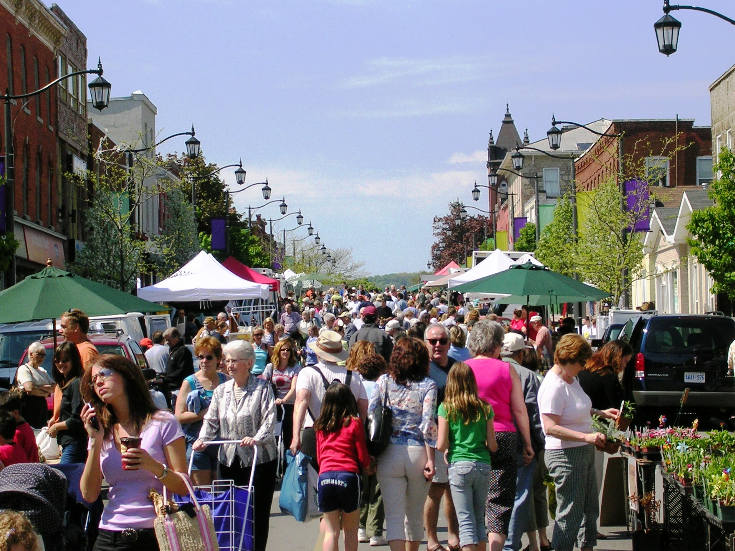
Information Needs of Business Owners
Notes:
Scott
One of the biggest issues facing Milton companies is employee recruitment and retention.
Not just the actual recruitment and retention, but also the theories, strategies and best practices in human resources. Even HR professionals have told us they need help.
This past year, the Chamber wanted a way to engage Milton’s larger employers who have certain labour laws and requirements in common….so we created an HR Roundtable to foster this engagement and to allow some peer-to-peer intelligence and problem solving.
What we discovered is HR professionals often feel isolated because they don’t necessarily have the funds to hire a consultant and they often cannot talk about issues with their internal teams….because sometimes they are the problem! ☺
This Roundtable has been a great success. WE have Milton’s top employers involved….including companies such as Chudleigh’s, Amazon and Lowe’s Distribution Centre.
But we felt there was a gap.

Slide 10
Building the Partnership
Notes:
Scott and Leslie
Scott:
We needed to find a way to offer some kind of similar support to the SME or small + medium business community. These mom & pop operations, the sole proprietors, or entrepreneurs that are not large enough to have an HR department, but still have HR concerns. We needed to find a way to build their knowledge, while also creating their own peer-to-peer resource group.
Leslie:
Scott, along with Chamber Board of Directors (now past) Chair Teresa Fujarczuk met early in 2017 with me to talk about the possibilities of developing some program directions that would benefit both groups. For MPL, we wanted to be able to demonstrate and encourage the use of the wonderful online resources, and further underscore the ability of library staff to generate the topics, design agendas, animate the discussions, and link participants with carefully chosen materials. We talked about book clubs. I talked about the amazing Gale courses. We thought about the most pressing concern of all employers: staffing, and chatted about how staffing challenges could be met across the Milton Chamber community, recognizing that in particular small and home based businesses are less likely to have the professional skills and knowledge at hand to help them navigate the mine field of HR in the 21st century. And thereby our direction was formed, and our pilot project year was set, and CLIC was born.

Slide 11
Chamber-Library Information Cohort
How about a new take on the traditional book club? One that allows busy businesspeople to learn and interact, but doesn’t require as much time and commitment. CLIC, a new joint initiative of the Milton Chamber of Commerce and Milton Public Library, is that fresh approach. We’ll read a pre-circulated article on a business topic and then meet to discuss and learn from one another. It’s informal and easy.
Notes:
Scott and Leslie
Scott:
Now, it’s a given that EVERYONE loves to read books….right?
Unfortunately, it’s also a given that businesspeople, like the rest of the world, are busy and pressed to find a lot of time. Unfortunately, some people’s attention spans have been reduced to sound bites…..maybe even 140 character conversations……sorry, now wildly expanded to 280 characters!!
So, that’s why we decided to take a new approach to a traditional book club. You can see here on the slide our initial description of CLIC which served as an outreach to the business community – and certainly it received interest and enthusiasm.
Leslie
MPL has a tremendous amount of online and physical resources that can be of inestimable benefit to local business owners and their staff. Connecting them with these resources in this fashion was a no-brainer, and I’m a wee bit embarrassed that I never thought of doing so before. On the plus side, waiting meant Anne was here to do the hard work, so in the end perhaps this was a happy thing. Facilitation skills!
MPL also has a tremendous number of skilled staff, with much to offer to the community, and to further demonstrate to partners and participants that this expertise exists, is valuable

Slide 12
Defining Roles
Notes:
Leslie
MPL has agreed with enthusiasm:
To provide the right level of staff resources to be engaged on the project monthly through the school year, and at least once in the summer to maintain connections by sending out a summer reading list
To look for and distribute content on specific themes, both online magazine and video
To develop questions and directions to encourage active participation and interaction
To encourage the use of other MPL resources
Scott
The Chamber also enthusiastically supported the program right from the start. Our role has been:
- to provide our Boardroom as the CLIC home
- advertising CLIC to our members
- recruiting applicable members to join CLIC
- giving administrative support, including managing registrations and disseminating meeting materials to CLIC participants
- and, of course, participating in CLIC sessions

Slide 13
Building the Program
Initial Themes:
Staffing for Success
Choose the Best Person for the Job
Know Your Rights and Responsibilities
Unlock the Potential of New Hires
Build an Effective Team
Inspire Exceptional Performance
Notes:
ANNE
Once Leslie and Scott had established our new program, I came in as the facilitator as the program. Having completed training called Becoming a Master Instructor in a former role, I was fairly confident coming in to facilitate the group discussion. I’m pleased to be able to share with you what the program has actually looked like in practise, in order that you can think about what kind of similar program might work for your library.
Initially, we had identified HR competencies as an area of interest for many Chamber Members. I reviewed different training sessions I had attended, as well as our library’s business collection. A set of themes began to emerge, and those themes – Staffing for Success – Choose the Best Person for the Job – etc. – became a launch point for our program.
What we envisioned at the beginning was a monthly meeting to discuss readings on each of these themes. Initially, we thought this would be a brown bag lunch – we scheduled at the first Tuesday of every month, from 12:00 noon to 1:00 pm, in our Milton Chamber of Commerce Boardroom. The boardroom has capacity for around 12 – 15 individuals, and we thought this would work well for discussions of these themes. At the outset, we believed the same people would attend each session – what actually turned out is that each session stood alone.

Slide 14
Inviting Participants
Notes:
ANNE
From the library perspective, we were lucky to be able to leverage the marketing talents of the staff at the Chamber of Commerce. Scott’s team at the Chamber made sure that our program was well represented on the web, that our invites went out via social media and their e-newsletter, and I was so pleased that the first month we had around 10 in attendance. I had built what I thought was a good springboard to the program, but as Leslie mentioned, we really wanted this to be participant driven – so thank goodness the Chamber had participants for us!

Slide 15
Letting business owners direct the conversation
Notes:
ANNE
Once we got started on the curriculum I had built, I was able to leverage the expertise and interest of the ever-changing cohort in defining future sessions.
As a librarian – and as the print collections manager for Milton Public Library – I was really interested to see that the types of things our participants were interested in actually mirror fairly closely the usage of our collections. You can see here the “hot topics” our participants were interested in – when I map that against the publishing trends, holdings, and circ of our business section at our Main Library, it’s really a very close comparison. That helped me inform future sessions, and the kind of content participants might be interested in.

Slide 16
Example Content
Notes:
ANNE
Each month, I would build a reading list around the specific themes that we were discussing. These readings pulled from online articles such as Harvard Business review, but importantly – also from library resources. I wanted to demonstrate to participants the value of what the library could bring them – typically, those included downloadable audiobooks. We might have been able to guess that among our busy group, the most popular resources and the ones that generated the most interest were those that were available immediately – for example, Gale Courses or Hoopla.
And again – knowing what I did from participant feedback – I tried to pull in the kind of content that we see on our library shelves.
You can see here an example agenda – and please don’t worry if you can’t see all the details in this. I wanted to show you the type of content I developed – and all of this will be made available to you after our presentation.

Slide 17
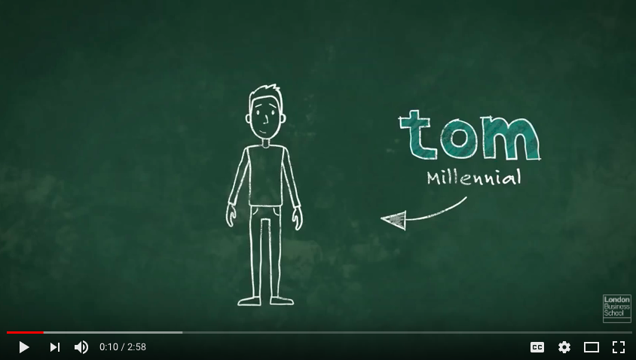
Example Content
Notes:
ANNE
I mentioned those “hot topics” that participants were interested in. As a facilitator, I tried to pull in some more “provocative” content – things that might cause people to disagree, or things that might cause people to have a strong opinion.
Certainly the strongest opinions out of all of our CLIC sessions was during one meeting where we discussed Managing the Multigenerational Workforce.
SHOW VIDEO
This kind of content kept participants engaged, interested, and more importantly – participating.

Slide 18
The evolution of CLIC
PROPOSED | DELIVERED
Staffing for Success | Staffing for Success
Know Your Rights and Responsibilities | Diversity in the Workplace
Choose the Best Person for the Job | Quick CLIC! Summer Reading List
Unlock the Potential of your New Hires | Managing a Multi-Generational Workforce
Build an Effective Team | Choose the Best Person for the Job
Inspire Exceptional Performance | Improve Workplace Communication
 | Personal Leadership
 | Inspire Exceptional Performance
Notes:
ANNE
CLIC was always intended to be a responsive initiative. It certainly did evolve over time – as we got to know our community better, and as I became a bit savvier as a facilitator as to what would draw participants in and really foster a vibrant discussion.
You can see here that the program I originally proposed evolved much past what I had imagined! While we had created a 6-month pilot, really, this has become an ongoing monthly initiative. The topics have changed to meet the interest levels of the participants. HR concepts are certainly core to our program, but we discuss HR themes in a really palatable way – with immediate takeaways for participants to implement.
The evolution of this project has really been quite fun – I’m a former children’s librarian – so it was very important to me that everyone have enough reading material over the summer, and so while we didn’t meet in July and August of last year, we did have a summer reading list with some really great content in it.

Slide 19
Staying Connected over the Summer
Notes:
ANNE
For the summer months, I sent out what we called a “Quick CLIC!”.
In mid to late July, participants received their summer reading. As with all summer reading, it was a bit “fluffier” than some of our regular content – but still really had some interesting, thought-provoking content behind it.

Slide 20
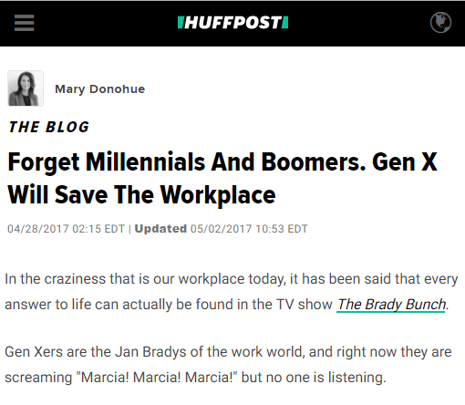
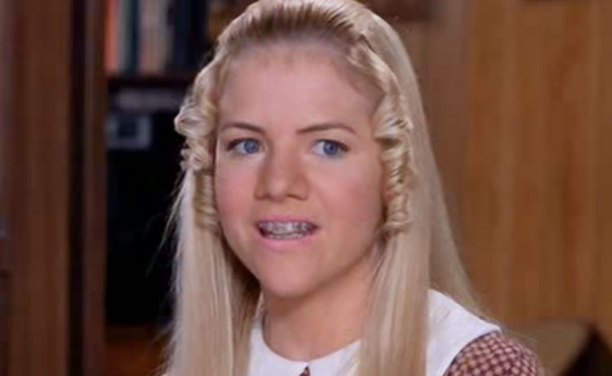
Staying Connected over the Summer
Notes:
ANNE
It was also good for a laugh – I mentioned the controversial session we had on Managing a MultiGenerational workforce – so I passed along an article that a member of the cohort had sent to me after that session – explaining the multigenerational workforce in terms of members of the Brady Bunch.

Slide 21
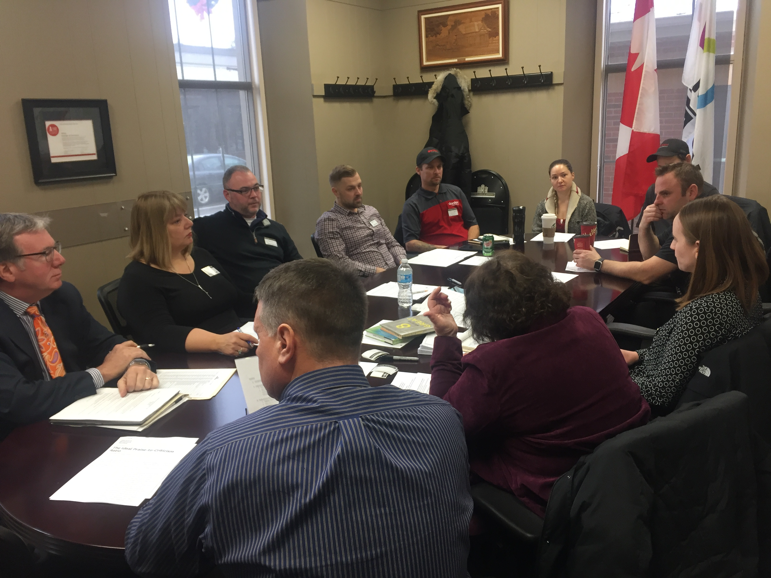
The expertise of the cohort
Notes:
ANNE
The Brady Bunch article – while it was really just a funny joke for our cohort over the summer – brings forward an important point.
Even by the summer – when I think we were only two or three sessions into CLIC – we had started to see the expertise of our participants coming forward. Not just in sharing jokes, but in sharing tips and tricks about the topics we were discussing.
A good example of this is a session where we talked about Effective Communication. A local restaurant owner said to the group that he can’t email out his shifts to his teenage staff anymore anymore – he has to text his staff. This spurred on a really interesting conversation – do we need to start texting our employees? Different businesses around the table had different options. Those from large organizations with more capacity had software solutions where employees could opt-in – to email, phone calls, or texts. While the method could differ from organization to organization, the message remained the same – we all have very diverse staff who prefer different modes of communication.
As a facilitator, I was really pleased to see this happening – we talk a lot in libraries about collaborative learning – and this was a perfect example of co-learning in practice. While no single one of us can be the expert on everything, we can leverage each other’s expertise and experience.

Slide 22
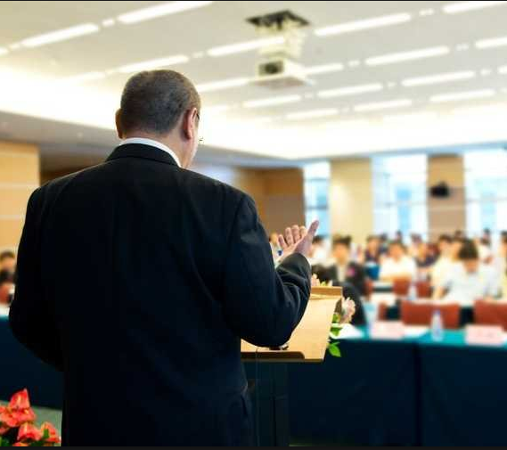
The role of Community Experts
Notes:
ANNE
In that same vein of trying to leverage the expertise and experience of Chamber of Commerce members, I tried a bit of an experiment.
Periodically within our sessions, I invited a community expert. For example, participants asked early on if we could have a session on promoting diversity in the workplace. Leslie referenced all the great partnerships that MPL has – and one of our partnerships, as I imagine it is for many of you, is with settlement services. I invited a Settlement Services specialist to come to our discussion around diversity in the workplace, and asked him to reflect on some of the feedback his clients have given him about what makes a workplace more welcoming.
That was absolutely a success. Our discussion was so much richer for having invited a community expert.
What wasn’t necessarily a success was another community expert I invited. Where our first expert was a casual part of our conversation, and enriched that discussion – our leadership expert came in as a formal presenter. He lectured the group for an hour, and it really didn’t suit the culture of CLIC. It became clear to me that the next time I invite an expert – and I will – I will clarify the importance of making sure that everyone at the table has a voice, and that this isn’t a workshop style or lecture style group. But what is great about this CLIC initiative is that we’ve been able to try some different things, and our openness to letting the initiative evolve has really informed its success. We continue to learn from every experience in CLIC and we’re prepared to have the odd thing that doesn’t work in the future as well.

Slide 23
Participant Feedback
“I have attended several CLIC sessions and have thoroughly enjoyed and benefitted from each. Meeting with others in our business community in a small focused group to discuss targeted issues in the workplace has provided much food for thought as well as specific strategies to consider. Receiving well-chosen articles and videos on the upcoming topic has been a great way to prepare for and to focus the discussion. Exceptionally well done and appreciated!”
Notes:
SCOTT
Share testimonials from CLIC attendees

Slide 24
Participant Feedback
“CLIC has provided me with a great network of professionals in my community; to share ideas and knowledge, to ask for feedback and to share points of view, to see things from another perspective and to learn from one another.”
“[CLIC] has given me a great opportunity to exchange ideas with other business people in the community. Actually, this to me, has been a byproduct of the meetings as I assumed that initially it would be more of a “read and learn” type of exercise but it has become so much more than that. The reading materials have been very educational but also have lead me to learn more about what it available to me through the library system that I had no idea about.”
Notes:
SCOTT
Share testimonials from CLIC attendees

Slide 25
Evaluating Success
Attendance
Interest
Participation
Relationship building
Buy-in from local businesses
Enthusiasm – and making it replicable to other municipalities
Notes:
Leslie
So far, we have met with dozens of employers and employees from across Milton, representing a number of different businesses. The discussion and engagement around the table has been enlightening and enthusiastic, and everyone does participate. Connections are being made on a number of fronts, and we certainly know that this is a project that will be continuing. And it is that certainty that fact that has brought us here today to share our plan and outcomes with you, with the recommendation to replicate what Milton has achieved in a way that makes sense for your home community. And if we can help, we certainly want to.
One thing that surprised me? Some of the bigger organizations also wanted in
Scott
What’s been interesting in rolling out CLIC is the reinforcement that face-to-face engagement is still valuable! As much as we think people are too busy to leave their offices and so might prefer on-line learning, there is still a place for human interaction! CLIC members enjoy the group discussions and like the thought-provoking opinions on the reading materials.
And, as much as we thought CLIC would mainly appeal to smaller companies, we also have participation from some of our largest local employers. In fact, some like Gordon Food Service are sending more than one person from their HR department as a bit of a professional development program.

Slide 26
What Next?
2018 program
Continuous evolution based on collaboration with partners and participants
Encourage the implementation of the project outside Milton
Notes:
Leslie and Scott
Leslie:
This pilot project will continue in 2018 as an established program, and the first session for 2018 was held on January 9th. For the foreseeable future, we will continue with the HR theme. As mentioned above, this is one area where small business owner / operators may be most challenged. By growing everyone’s skillset, and gaining the knowledge of where and how to find information can only benefit the businesses and people of Milton in the short and long term.
Scott:
And, we think CLIC has a future outside of Milton……with Chambers, Boards of Trade and Libraries throughout Ontario. We have been pleased to describe CLIC to you here this morning. My plan to also now tell the Chamber network about what we’ve accomplished and how easily replicated CLIC can be for their communities.

Slide 27
Take-Aways
Find a skilled facilitator
Leverage the expertise of participants
Allow the program to evolve naturally over time
Be reasonable in expectations of participants – curate digestible content
Where it makes sense, invite local experts to animate discussions
Keep it interesting!
Notes:
Scott
We’ve learned a lot over the past year or so that we’ve been implementing CLIC.
A few key takeaways – It’s important to foster an interesting discussion, that brings forward the expertise of the group members.
The program does have to evolve over time – participants will tell you what they want from the program.
It’s also important to be respectful of our businesspeople – they’re BUSY! Any content provided does have to be in digestible chunks.
And it’s always worth trying new things – we tried out inviting community experts, and we’ll continue to do that where we think it makes the conversation richer.

Slide 28
Implementing in Your System
Please download our MPL Facilitator Guide to the Chamber-Library Information Cohort from the OLA SC website – or email Anne for an advance copy!
Don’t hesitate to reach out to us and we’d be happy to chat.
Notes:
ANNE

Slide 29
Questions?

Slide 30
Stay in Touch
Leslie Fitch, CEO and Chief Librarian,
Milton Public Library, leslie.fitch@mpl.on.ca
Scott McCammon, President and CEO,
Milton Chamber of Commerce, scott@miltonchamber.ca
Anne O’Sullivan
Manager, Information Services and Programming,
Milton Public Library, anne.osullivan@mpl.on.ca
Notes:
ANNE

Slide 31
Thank you
Notes:
ANNE
Thank you for your interest.
Is there any questions?

